Slide 1

NLP and Word Embeddings
Word representation
deeplearning.ai

Slide 2
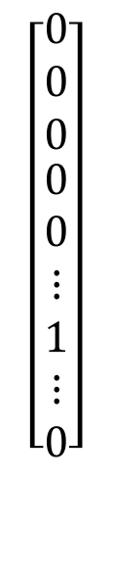
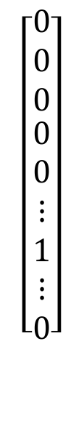
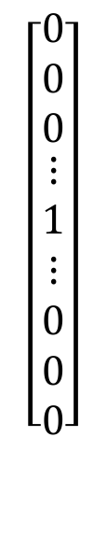
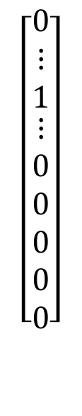
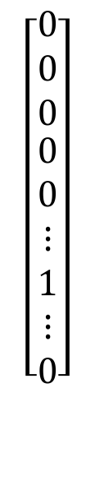
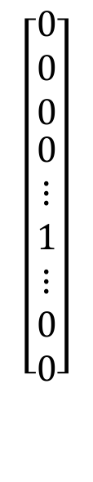
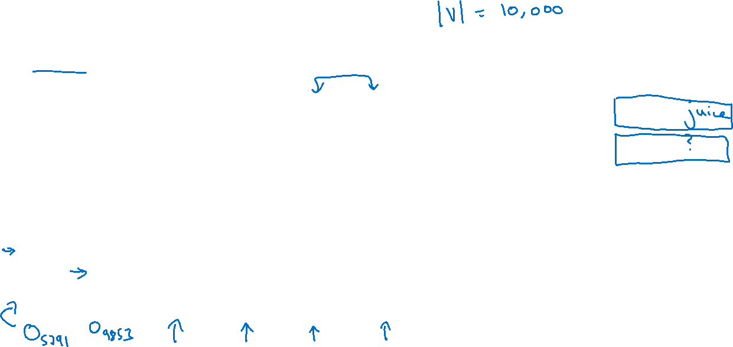
Word representation
V = [a, aaron, …, zulu, <UNK>]
1-hot representation
Man
(5391)
Woman
(9853)
King
(4914)
Queen
(7157)
Apple
(456)
Orange
(6257)
I want a glass of orange ______.
I want a glass of apple______.
$$\left[\begin{aligned}\begin{matrix}0 \\ 0 \\ 0\end{matrix} \\ 0 \\ ⋮ \\ 1 \\ ⋮ \\ 0 \\ 0\end{aligned}\right]$$
$$\left[\begin{aligned}\begin{matrix}0 \\ 0 \\ 0\end{matrix} \\ 0 \\ 0 \\ ⋮ \\ 1 \\ ⋮ \\ 0\end{aligned}\right]$$
$$\left[\begin{aligned}\begin{matrix}0 \\ 0 \\ 0\end{matrix} \\ ⋮ \\ 1 \\ ⋮ \\ 0 \\ 0 \\ 0\end{aligned}\right]$$
$$\left[\begin{aligned}\begin{matrix}0 \\ 0 \\ 0\end{matrix} \\ 0 \\ 0 \\ ⋮ \\ 1 \\ ⋮ \\ 0\end{aligned}\right]$$
$$\left[\begin{aligned}\begin{matrix}0 \\ ⋮ \\ 1\end{matrix} \\ ⋮ \\ 0 \\ 0 \\ 0 \\ 0 \\ 0\end{aligned}\right]$$
$$\left[\begin{aligned}\begin{matrix}0 \\ 0 \\ 0\end{matrix} \\ 0 \\ 0 \\ ⋮ \\ 1 \\ ⋮ \\ 0\end{aligned}\right]$$

Slide 3


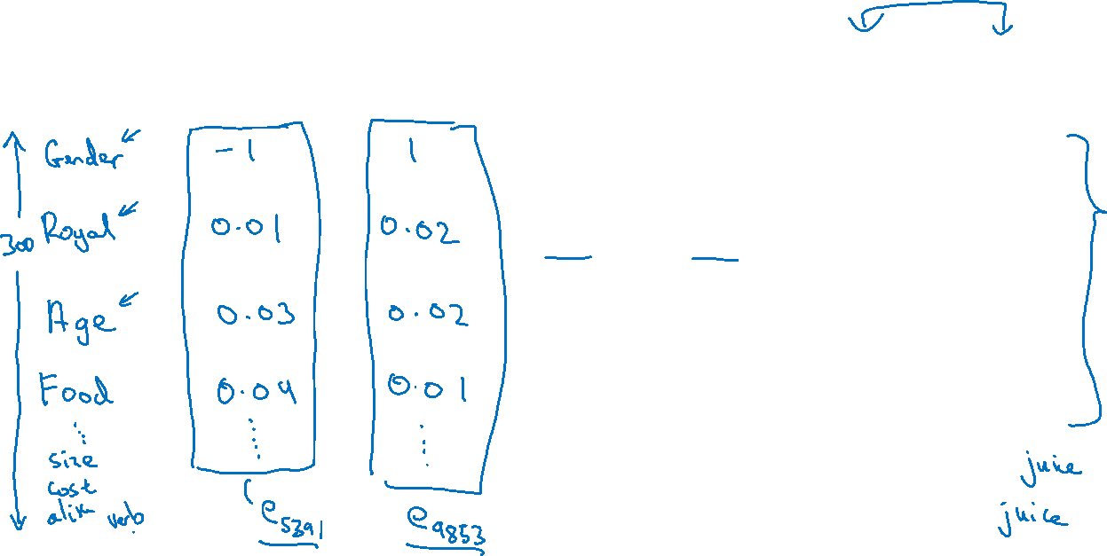
Featurized representation: word embedding
Man
(5391)
Woman
(9853)
King
(4914)
Queen
(7157)
Apple
(456)
Orange
(6257)
-0.95
$$0.97$$
0.00
0.01
0.93
$$0.95$$
-0.01
0.00
0.7
0.69
0.03
-0.02
0.02
0.01
0.95
0.97
I want a glass of orange ______.
I want a glass of apple______.

Slide 4
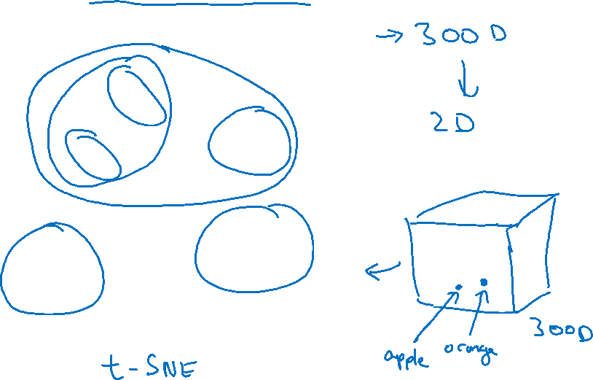
Visualizing word embeddings
man
woman
dog
king
cat
queen
fish
apple
grape
three
four
one
orange
two
[van der Maaten and Hinton., 2008. Visualizing data using t-SNE]

